Slide 1
Protecting Linux with a Custom Loadable Kernel Module (LKM)
Project Credits
This project was developed by:
Muhammad Ali
Dilawer Khan

Slide 2
01
What is a Loadable Kernel Module (LKM)?
02
The Security Problem We Aim to Solve
Overview of the Presentation
03
execve & Process Launch Control
04
Using ftrace for Function Hooking
05
Demonstration and Results

Slide 3

What is a Loadable Kernel Module (LKM)?
Definition
A Loadable Kernel Module (LKM) is a piece of code that can be loaded into the kernel at runtime, extending its functionality without rebooting the system.
Use Cases
LKMs are commonly used for adding device drivers, system call extensions, or for monitoring and security purposes in Linux systems.
Why It Matters Here
Our project uses a special kernel module (called an LKM) to keep an eye on important system functions. It helps block or allow programs based on rules we set, so that only trusted programs can run. This helps protect the system from harmful or unauthorized software.

Slide 4
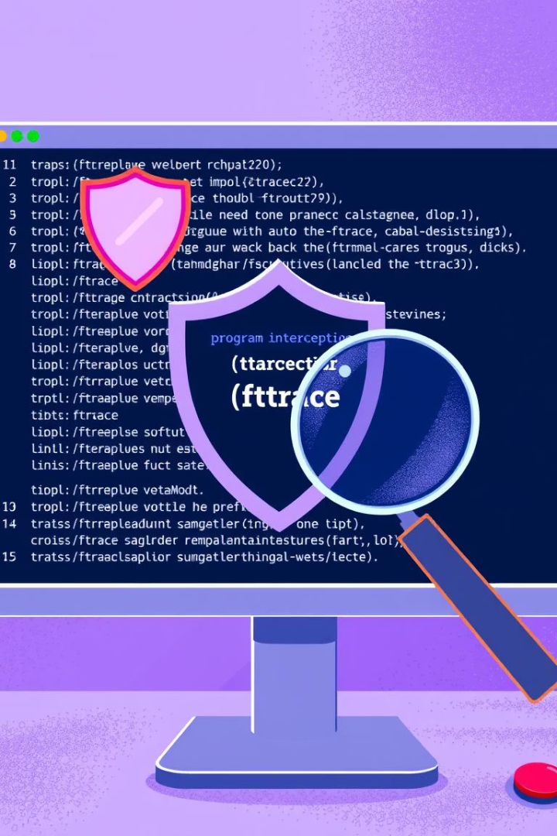
The Security Problem We Are Solving
Risky Program Access
In Linux, non-root users can launch powerful or dangerous binaries that may compromise system integrity or privacy.
Insufficient Controls
Regular permission settings and tools like AppArmor or SELinux can sometimes be set up incorrectly or bypassed, which can leave the system open to attacks.
Our Solution
We use LKM that watches for program execution requests (called execv calls). It blocks dangerous programs fromrunning for normal users but lets the root user run them after the module is installed.

Slide 5
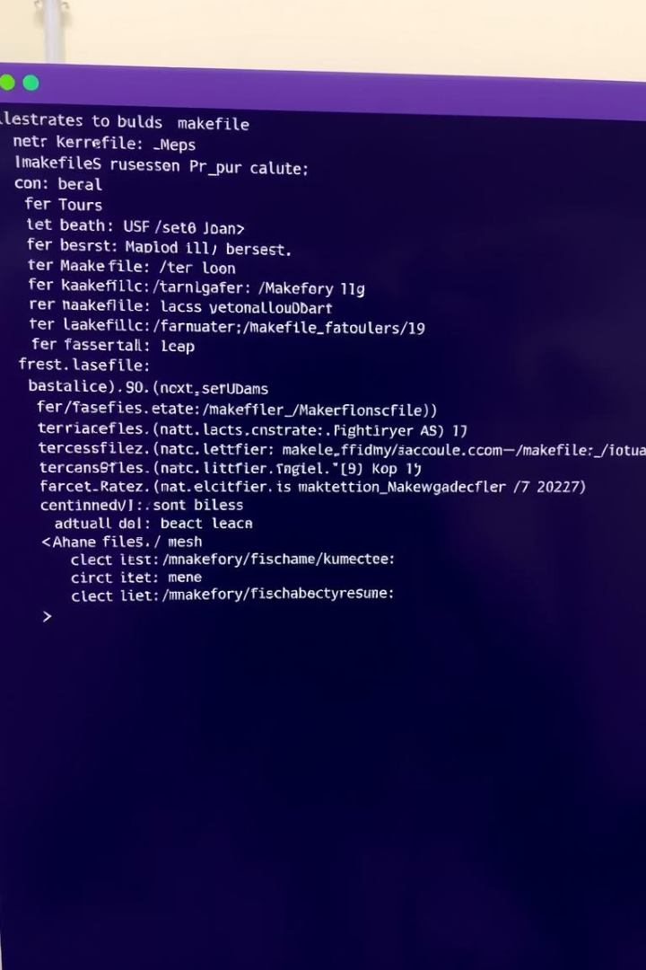
How execve is Involved
Understanding execve
execve is a system call in Linux that runs a new program, replacing the current one. It takes the program's name, any input arguments, and environment settings to start it.
execve’s Role in Our System
Our LKM uses a tool called ftrace to hook into the execve system call. It checks which program is being run and decides whether to allow it based on who the user is.
Custom Behavior
We add checks that block risky programs for normal users. This gives us custom control without changing the core parts of the system directly.

Slide 6
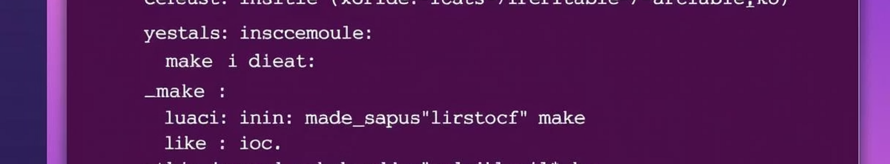
Using ftrace to Hook execve
What is ftrace?
ftrace is a powerful tool in Linux that helps track which functions are being called inside the kernel. It’s useful for checking performance, debugging, and understanding how the system works.
How We Use It
We use ftrace to connect to the execve system call while the system is running. This lets our module watch and change how programs are run, based on our own rules.
Advantages
This method doesn't change the system call table directly. Instead, it gives us a safer and easily reversible way to watch and control how the system works.

Slide 7

Key Functions in the Implementation
install_hook()
This function sets up the ftrace hook for execve, so our module can catch and control when programs are run
hook_execve()
A custom function that checks the user’s privileges, looks at the program being run, and decides if it should be allowed or blocked.
remove_hook()
This function removes the ftrace hook so that the system works normally again when the module is taken out.

Slide 8
Reflection
Why is this project significant for real-world Linux security?
Conclusion & Defense Readiness
Our custom LKM improves Linux security by blocking high-risk programs for regular (non-root) users. It uses ftrace to safely monitor and control program execution without changing the system’s core tables. This shows a strong understanding of how kernel modules, system calls, and security methods work.

Slide 9
Function: check_path()
Purpose
The check_path() function checks if the program being run is on a restricted list set by the module. It makes sure that only the root user can run those risky programs.
Implementation Detail
It checks the program’s name against a list of blocked names. If there’s a match and the user isn’t root, the program is blocked.
Security Role
This function is the main gatekeeper. It stops regular users from using sensitive tools like bash, sh, or netcat if they’re not root.

Slide 10
Function: thunk()
What is thunk()?
The thunk function is a custom hook that uses ftrace to replace the original sys_execve. It catches execution requests, checks them, and then lets the real system call handle the action.
How it Works
When a user tries to run a program using the execve syscall, thunk() catches it. It runs check_path() to decide if the program can run. If it’s allowed, it sends the request to the real sys_execve.
Importance in Control Flow
It works like middleware, adding custom checks to the system call process. This redirection filters user access without changing the syscall table directly.

Slide 11
Function: install_hook()
Purpose of install_hook()
The install_hook function puts our custom thunk into the ftrace system. This makes sure that execve is only watched when our LKM (module) is running.
How It Works
It uses ftrace’s register_ftrace_function() to link execve to our thunk. It also sets filters with ftrace_set_filter_ip() to make sure the redirection only happens under certain conditions.
Critical Role
Without install_hook, the LKM won’t change how system calls work. This function smoothly enables our security checks while the system is running, without modifying the syscall table.

Slide 12
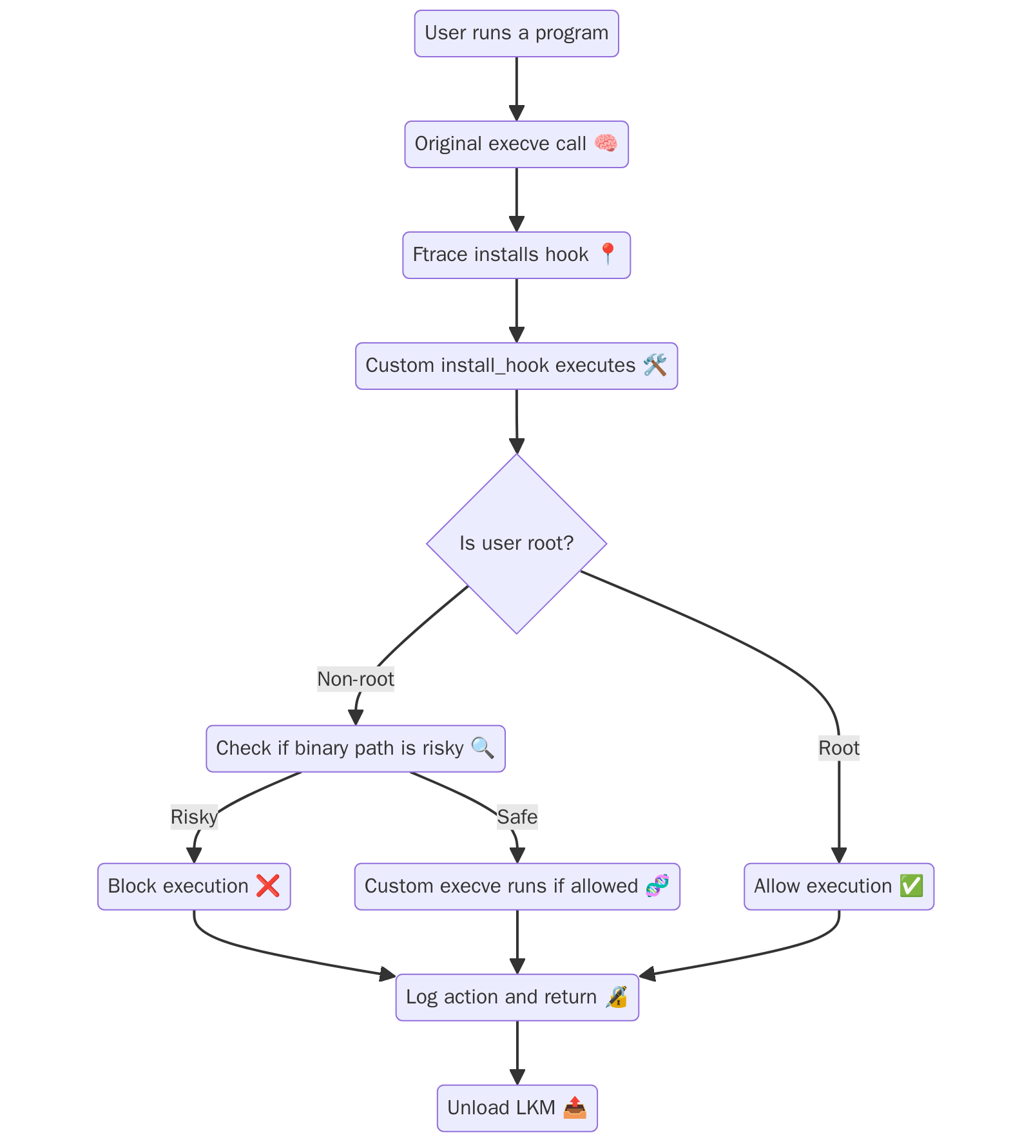

Slide 13
Kprobes & kallsyms Lookup
The Problem with kallsyms_lookup_name
In newer versions of Ubuntu, the kallsyms_lookup_name function is no longer available by default, which makes it harder for developers to find symbols dynamically in kernel space from loadable kernel modules (LKMs).
Our Solution:
To solve this, we used kprobes, a debugging tool in the kernel. We set a temporary probe on a known function and used it to find the address of kallsyms_lookup_name, allowing us to access it indirectly.
kallsyms_lookup_name
The kallsyms_lookup_name function is used to find the addresses of kernel functions while the system is running. It's important for looking up functions like sys_execve in a way that works on different systems.
Why It Matters
These tools make the LKM flexible and portable across different kernel versions by finding addresses while the system is running, so there’s no need for static linking or rebuilding the kernel.

Slide 14


